Slide 1
guide to the foundation What we fund how we are funded how to get money

Slide 2
What DOES the Foundation FUND?
Mission: To raise funds and build community partnerships to maximize educational success for all students. We align, support and enhance District priorities for student learning and success.
The Foundation has granted $2.9 million to NSD schools and students.
We prioritize projects, supports and experiences that:
Enhance and inspire learning, increase curiosity, provide real-world experiences or encourage innovation.
Provide personalized student support to remove barriers to learning which cannot be done by the District due to state and federal restrictions.
Prepare students for post-secondary education and careers and help students mature into productive and engaged citizens.
Learn more on our website: Who We Are

Slide 3
How is the foundation funded?
The Northshore Schools Foundation is a local 501(c)3 non-profit charity that serves students and teachers in the Northshore School District, which serves the local communities of Bothell, Kenmore, and Woodinville. The Foundation is funded solely by private contributions and operates separately from the Northshore School District. Ways donors can give include:
Corporate sponsorships
Workplace giving: District annual charitable giving campaign
Fundraising events
Individual donations
Corporate matching
Learn more on our website: Ways To Give

Slide 4
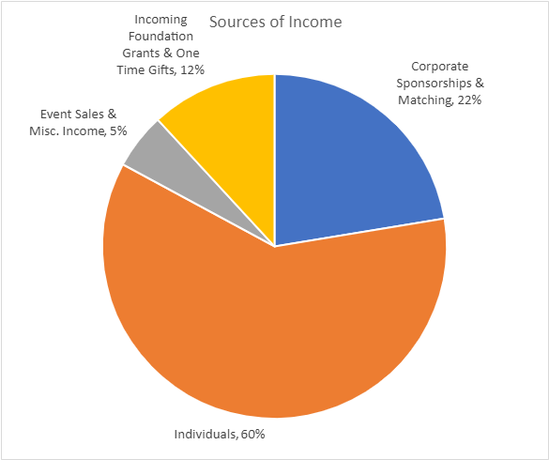
How is the foundation funded?

Slide 5
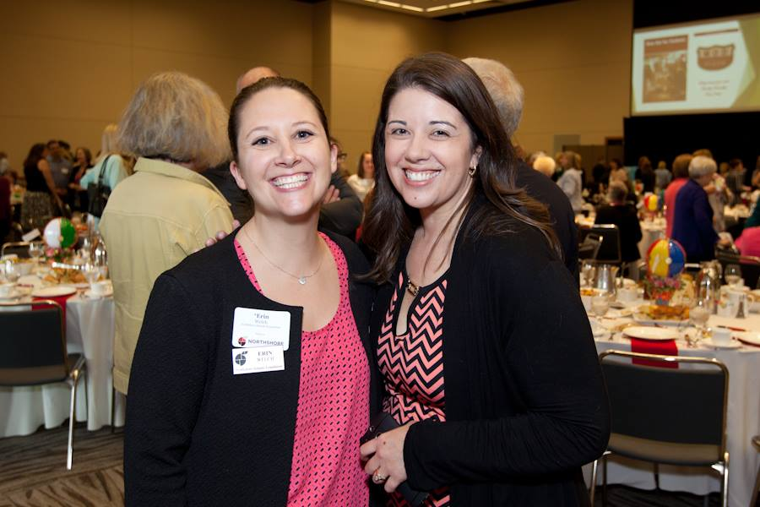
Staying connected with the foundation
Your school Ambassador is <YOUR CONTACT INFO HERE>
Ambassadors are parent volunteers at your school who represent the Foundation and maintain collaborative and mutually beneficial relationships with school staff and PTA. Ambassadors are your first point of contact for questions and assistance with grant applications or general questions about The Foundation.
Find our list of Ambassadors on our website: Who We Are

Slide 6
Staying connected with the foundation
There are several ways for you to stay in-the-know. Choose whichever works best for you!
Sign up for our Newsletter
(use your @nsd.org email so we know you’re an educator and can send you specific opportunities for educators)
Website Blog
Social Media Channels
Facebook
Instagram
Twitter
You Tube Channel

Slide 7
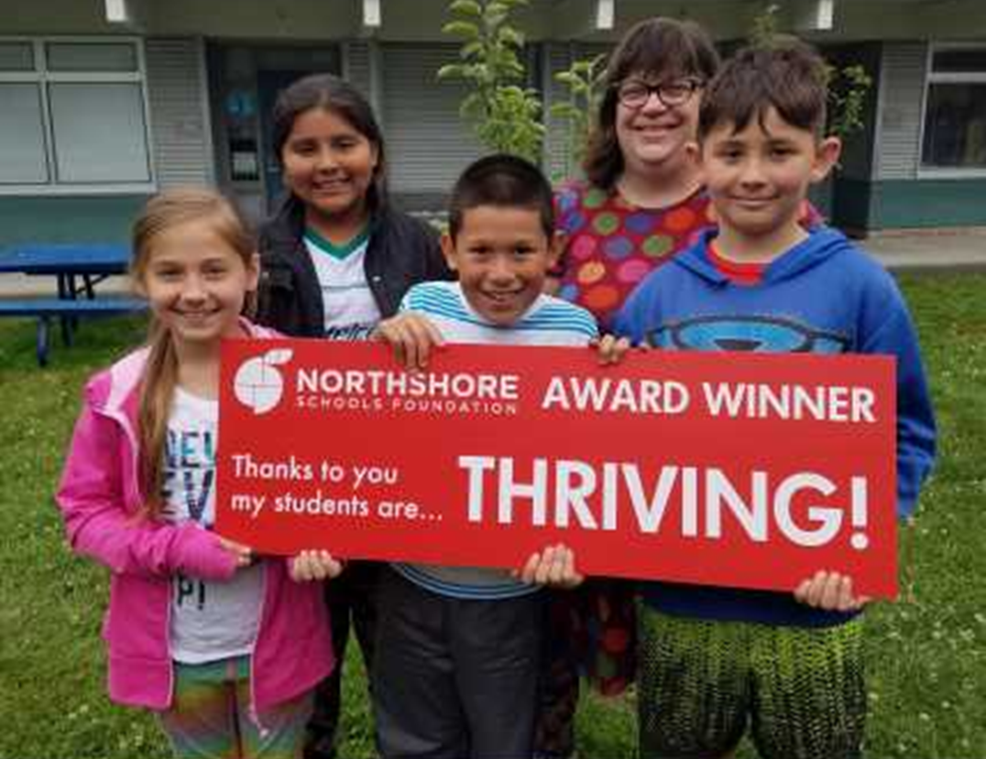
Elementary grants
There are two ways to apply for funding:
Traditional grant
Crowdsourced fundraising
Both applications are done online using the FoundationGive.com platform.
Northshore Schools Foundation Request Funds
Application deadlines for 2021-2022 school year are 8/30, 10/30, 12/30, 2/28, 4/30 and 6/30.

Slide 8
Elementary grants
Traditional Grant
Elementary teachers and staff can request funds for classroom grants up to $1000. The grant award is funded 100% by the Foundation. Step-by-step instructions are found on the website.
Northshore Schools Foundation Request Funds

Slide 9
Elementary grants
NorthshoreGives/Crowdsourced Funding
Great for (but not limited to) projects that exceed the $1000 grant limit. Crowdsource-funded projects will seek donors directly by creating a fundraising campaign that can run between 2-6 weeks. The Foundation may decide to provide funding for your project if the crowdsourcing does not reach the needed amount.
Step-by-step instructions are found on the website.
Northshore Schools Foundation Request Funds

Slide 10
Elementary grants

Slide 11
Elementary projects funded

Slide 12
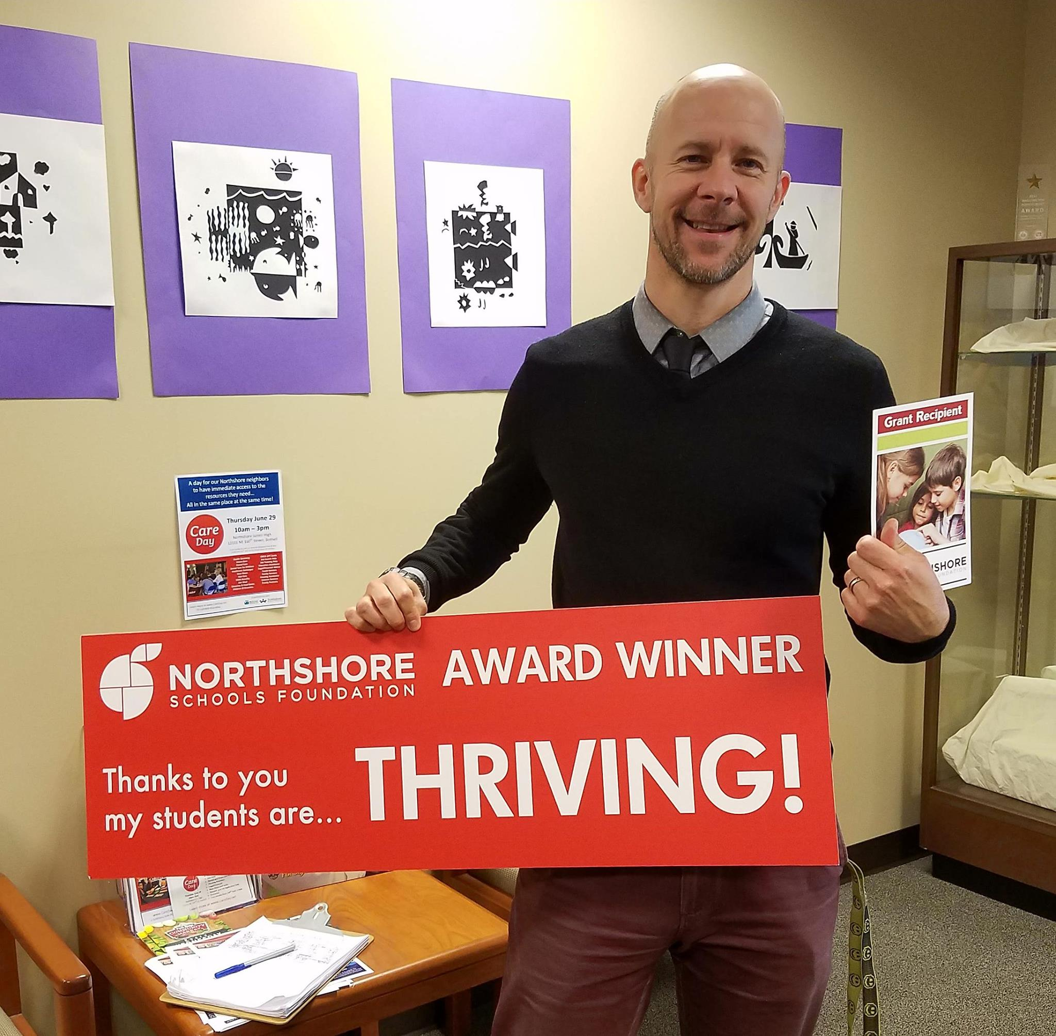
middle school grants
There are two ways to apply for funding:
Traditional grant
Crowdsourced fundraising
Both applications are done online using the FoundationGive.com platform.
Northshore Schools Foundation Request Funds
Application deadlines for 2021-2022 school year are 8/30, 10/30, 12/30, 2/28, 4/30 and 6/30.

Slide 13
middle school grants
Traditional Grant
Middle School teachers and staff can request funds for classroom grants up to $1000. The grant award is funded 100% by the Foundation. Step-by-step instructions are found on the website.
Northshore Schools Foundation Request Funds

Slide 14
middle school grants
NorthshoreGives/Crowdsourced Funding
Great for (but not limited to) projects that exceed the $1000 grant limit. Crowdsource-funded projects will seek donors directly by creating a fundraising campaign that can run between 2-6 weeks. The Foundation may decide to provide funding for your project if the crowdsourcing does not reach the needed amount.
Step-by-step instructions are found on the website.
Northshore Schools Foundation Request Funds

Slide 15
Middle school grants

Slide 16
middle school projects funded

Slide 17
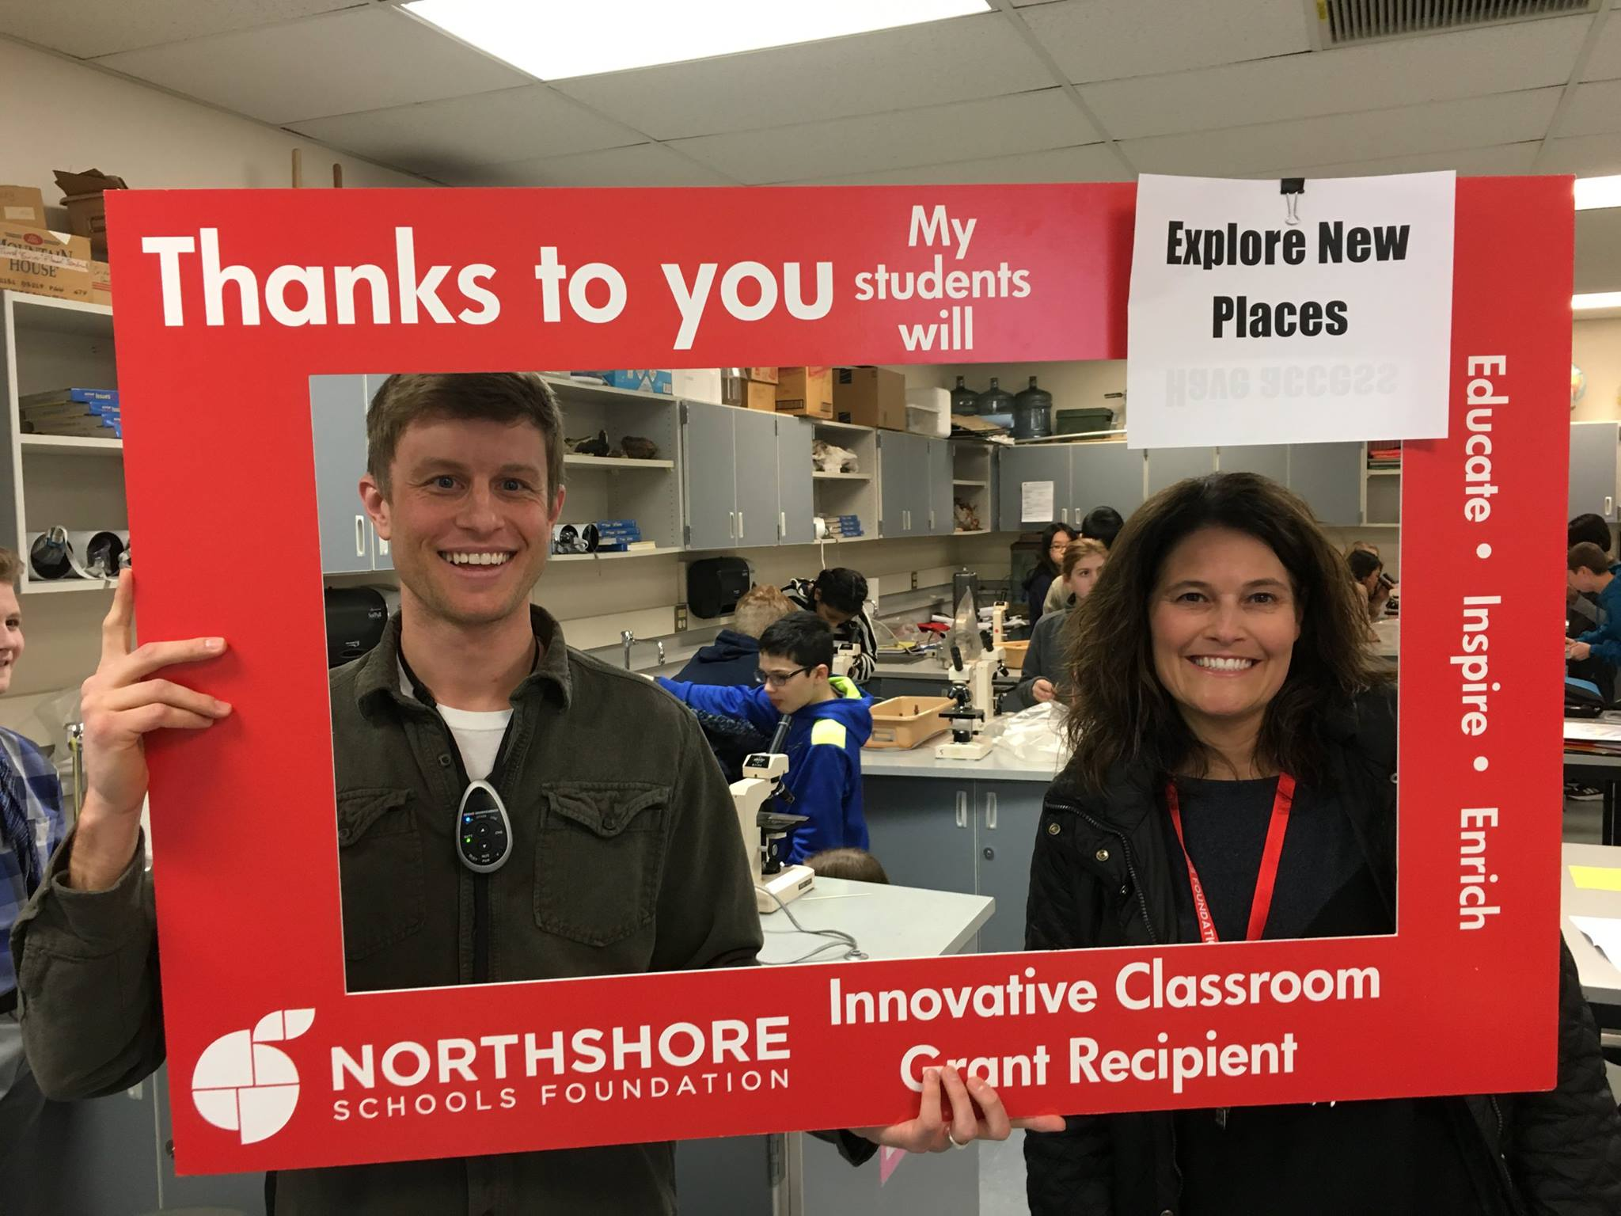
high school grants
There are two ways to apply for funding:
Traditional grant
Crowdsourced fundraising
Both applications are done online using the FoundationGive.com platform.
Northshore Schools Foundation Request Funds
Application deadlines for 2021-2022 school year are 8/30, 10/30, 12/30, 2/28, 4/30 and 6/30.

Slide 18
high school grants
Traditional Grant
High School teachers and staff can request funds for classroom grants up to $1000. The grant award is funded 100% by the Foundation. Step-by-step instructions are found on the website.
Northshore Schools Foundation Request Funds

Slide 19
high school grants
NorthshoreGives/Crowdsourced Funding
Great for (but not limited to) projects that exceed the $1000 grant limit. Crowdsource-funded projects will seek donors directly by creating a fundraising campaign that can run between 2-6 weeks. The Foundation may decide to provide funding for your project if the crowdsourcing does not reach the needed amount.
Step-by-step instructions are found on the website.
Northshore Schools Foundation Request Funds

Slide 20
High school grants

Slide 21
high school projects funded

Slide 22
Preparing a Crowd-sourced application
Title your campaign and choose a shorter version as the “slug”, which is the tag that creates the web address for your campaign
Fill in the goal/need amount. 5% of the total will be added to cover credit card fees and administration of the grant
Summarize your need in an inspiring and succinct description. Ask your Ambassador or Foundation staff for help if necessary
Upload a compelling photo that supports your campaign request
Note you will be asked to send an update to donors using this platform within 2 weeks of receiving funds
Find more details on our website: Northshore Schools Foundation Request Funds

Slide 23
Preparing a grant application?
Provide an overview of the project (Limit to 300 characters)
Project description: What are the funds for? When and where will this project take place? List and explain the numbers and roles of all participants (< 400 words)
What sparked your interest to offer this project to your students? (< 250 words)
Describe your due diligence in determining the best value for your funding request (<100 words)
How does your project align with the Mission, Vision and Values of the Northshore Schools Foundation? (< 250 words or less)
Describe how your project aligns with the Northshore School District’s Strategic Plan Goals? (< 200 words)
How will students benefit
How will you measure success as a result of this grant
Find more details on our website: Northshore Schools Foundation Request Funds

Slide 24
Ambassador take-aways
If you are on the CARE Team, connect with your Ambassador at the beginning of the school year
We are looking for an Educator Ambassador at your school. Could that be you?
<Ambassador Contact Information here>

Slide 25
Educator take-aways
Apply for funding on the website: Northshore Schools Foundation Request Funds
Remember the application deadlines for 2021-2022 school year are 8/30, 10/30, 12/30, 2/28, 4/30 and 6/30
Send us your Teacher Wish List!
Stay in touch for emergent opportunities. Sign-up for the newsletter with your .nsd email to also receive opportunities specific to educators
Watch for events throughout the school year

Slide 26
Thank you for your partnership!

